Slide 1







Supporting Service Children

Slide 2


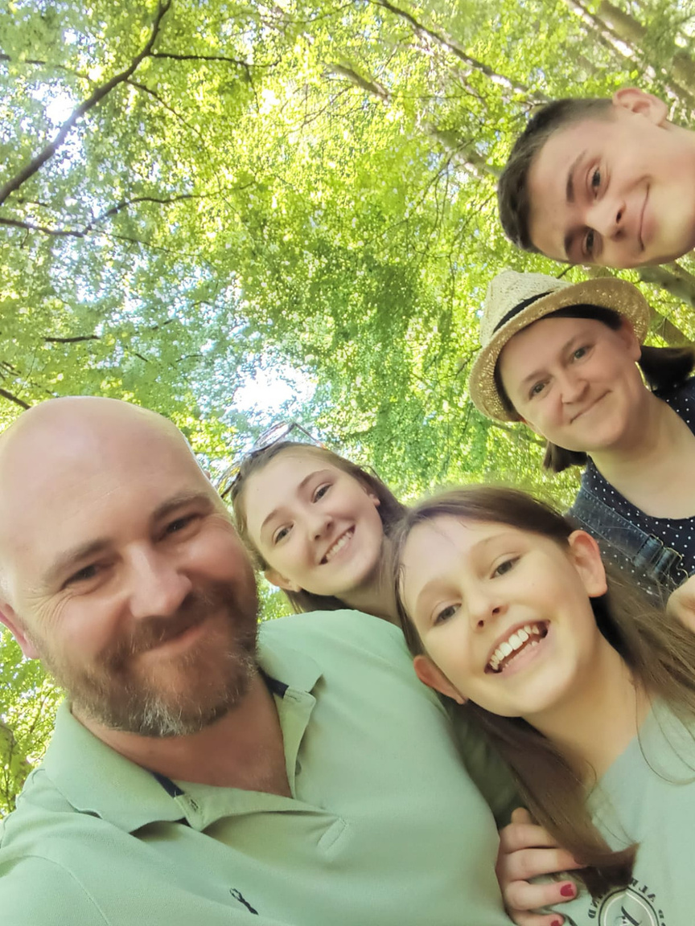


Service Child Definition
A person whose parent, or carer, serves in the regular armed forces, or as a reservist, or has done at any point during the first 25 years of that person’s life.

Slide 3


    3653 Service Children in North Yorkshire (November 2022) - one of the largest populations in the country
    North Yorkshire is home to the largest garrison in Europe - Catterick
    223 schools have a Service pupil footprint
    The average number of Service children per school is 11
Putting it into context...

Slide 4




What are the challenges Service children and young people face?

Slide 5

Mobility

Slide 6

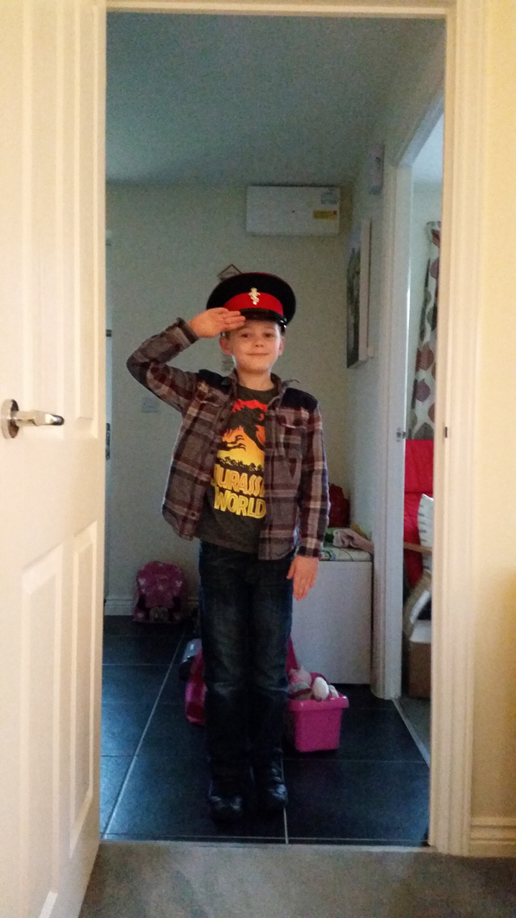



    Frequent moves
    Dips in learning
    Repeating areas of the curriculum
    School/Nursery admissions
    Friendships
    SEND
    Having to create new support networks
    Needing to adapt to new school rules and policies

Slide 7





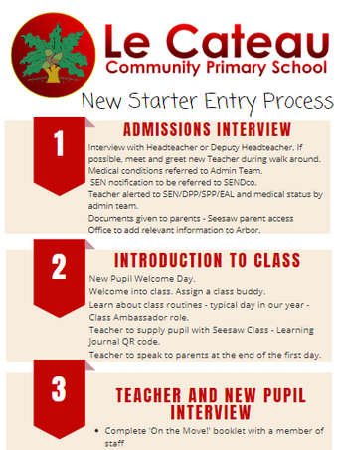
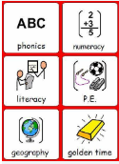
How to support children
Pupil Passports
Communication
Feeling Safe

Slide 8
Deployment

Slide 9

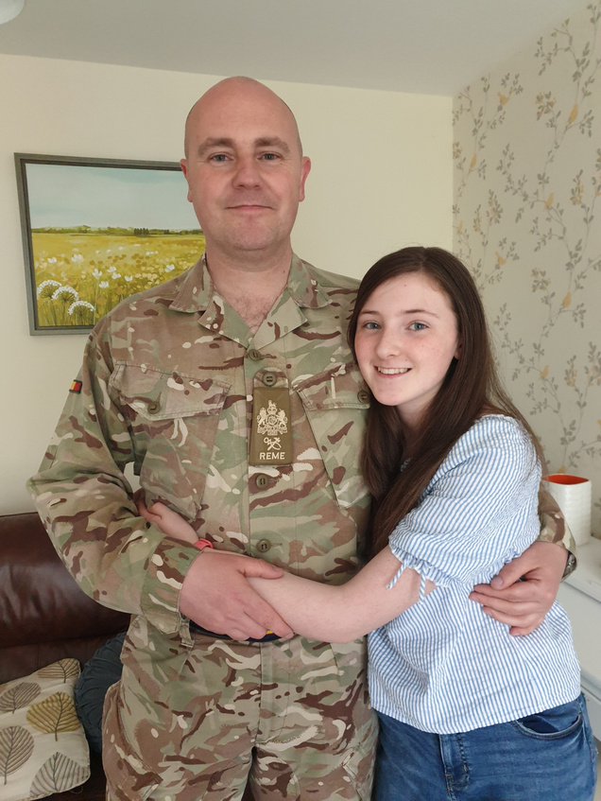
    Uncertainty
    Anxiety
    Anticipation of loss
    Frustration
    Detachment
    Loneliness
    Disruption to family routines
    Communication
    News reports
    Vulnerability
    Re-integration

Slide 10
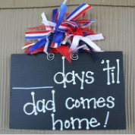

How to support children
Countdowns
Comforters
Reading

Slide 11
Well-being

Slide 12

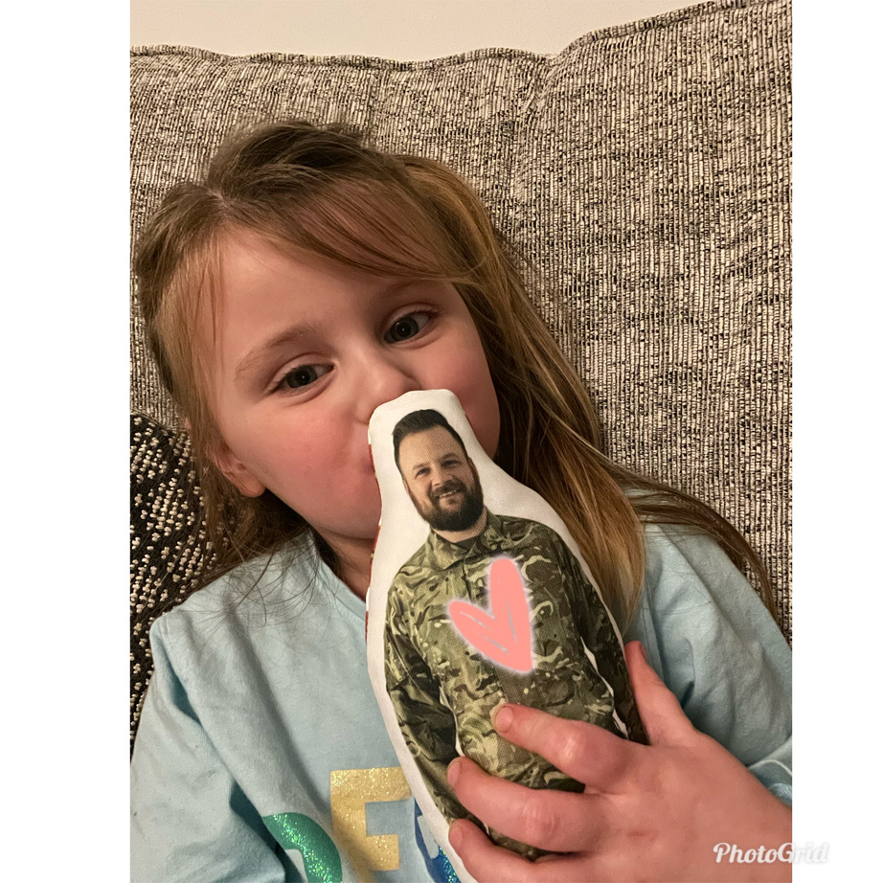
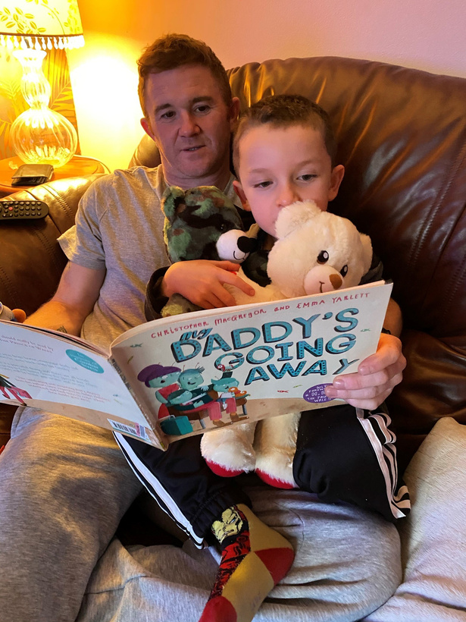
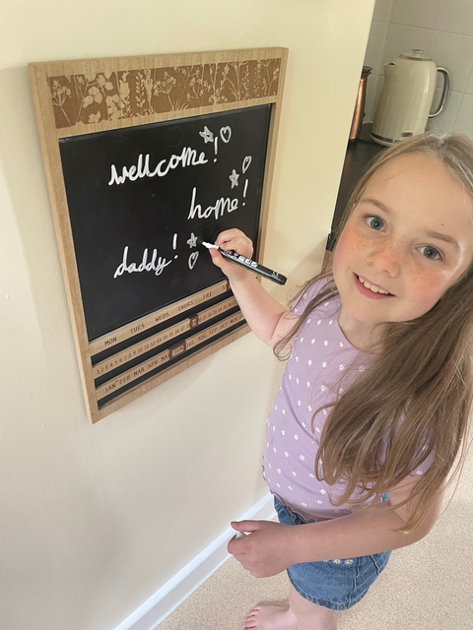
How to support children
Countdowns
Comforters
Reading

Slide 13

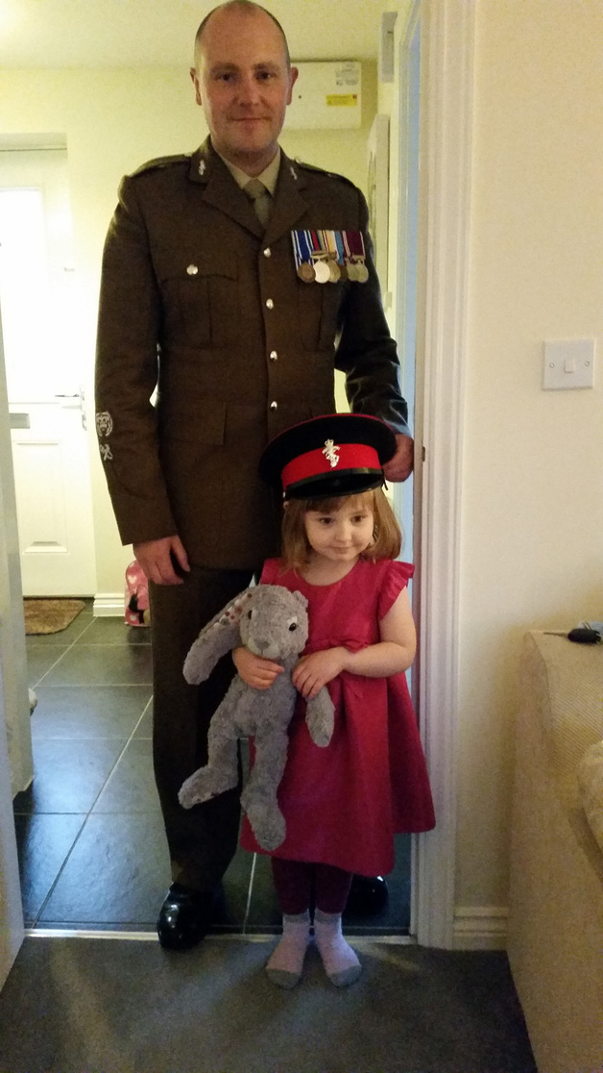
    Mental health
    Lack of family support networks
    Having to 'step up' due to absence of a parent
    Putting on a 'brave' face
    Young carers

Slide 14
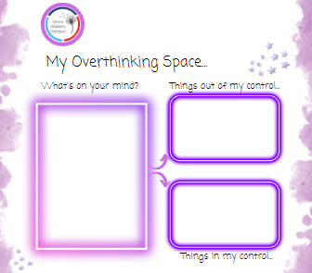
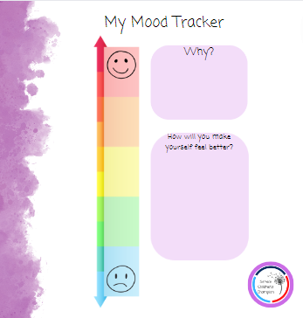
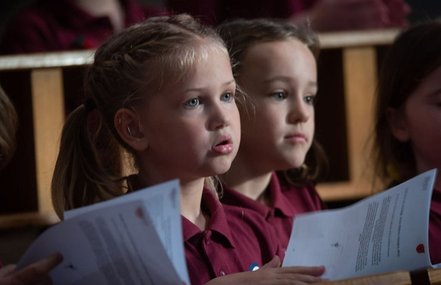
How to support children
Coping Strategies
Feelings
Self-Care

Slide 15
Additional support for Service children

Slide 16

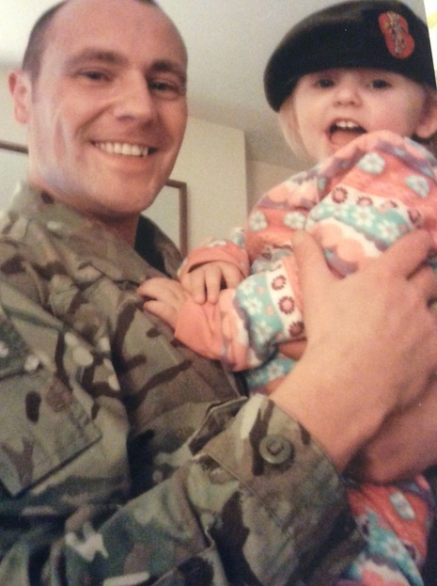


Examples from Le Cateau...
Family social events to create opportunites for networking and develop community links
Ensuring that the Service Pupil Premium strategy is in place and aims to support as many children as possible
Emotional first-aid training has been provided so that staff can help children experiencing anxiety due to deployments and transition periods.

Slide 17

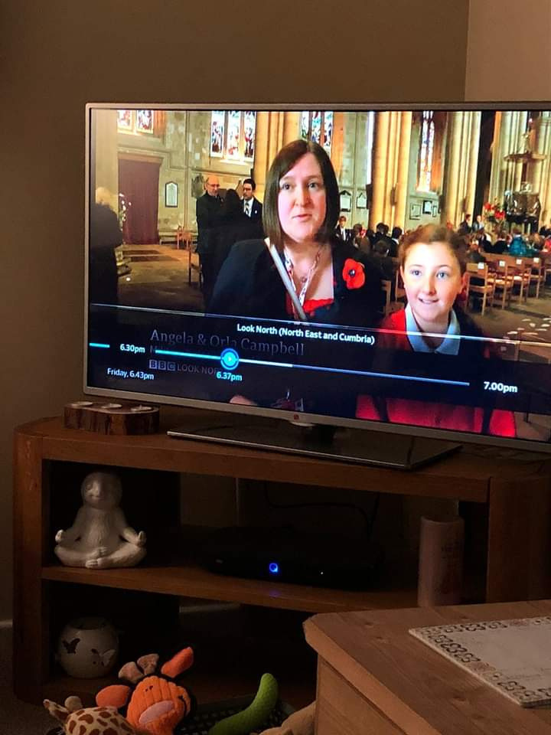
Further examples of support...
Signposting parents to organisations who can offer support or advice such as CEAS, AFF, Scotty's Little Soldiers
Using technology effectively to support military families such as Seesaw, social media, websites and TEAMS.
Creating opportunities to raise awareness and advocate on behalf of Service children

Slide 18
Let's celebrate...

Slide 19



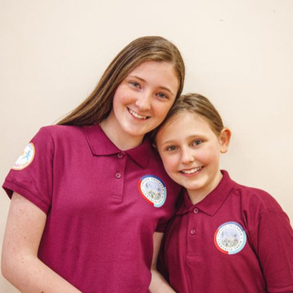
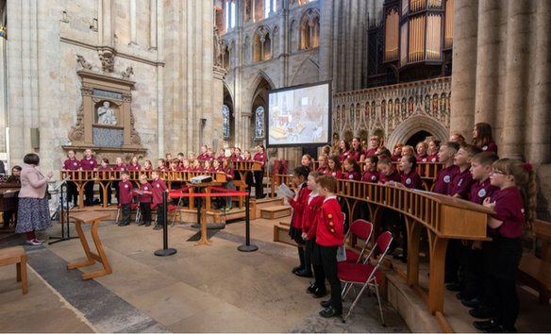

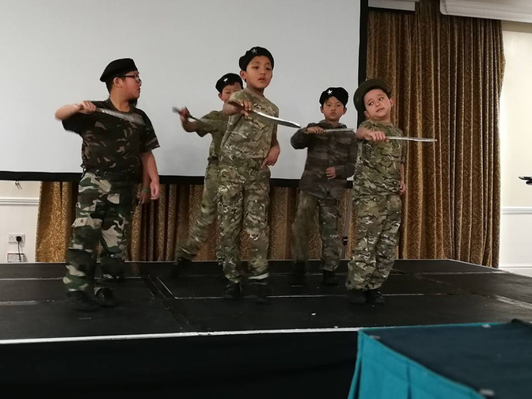

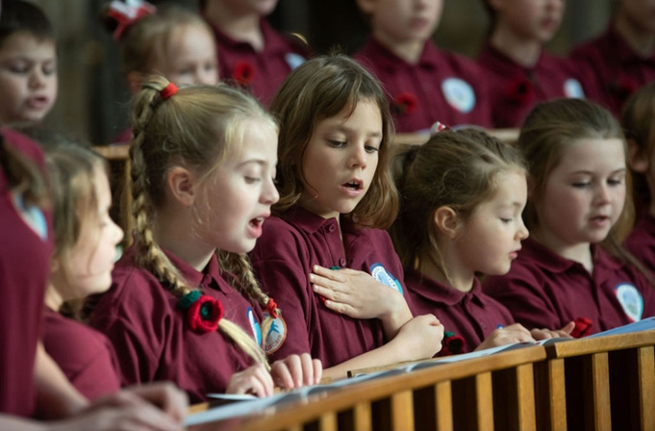



Slide 20
As you well know it is very difficult for some children to settle when they are continually moving about with a serving parent. My son was certainly no exception to this and struggled massively for a good number of weeks before we could leave him without tears. A special thank you to Mrs. Campbell who taught my son for the two years. Words are not enough to explain the influence she had on him and still has. – J. Brown

Slide 21
Having recently returned from Kuwait our daughter has found the choir to be the perfect way to make friends and grow confidence in a new school, new surroundings and while away from family, it's a completely new context. As parents it has given our weekends purpose and structure, it's brought us together in support of our daughter and we love seeing all the children embrace the identity of being a military child. So often they just absorb the downside to serving parents but this is their chance to see the benefits. they make us proud everyday. – D. Bell

Slide 22



Thank You
Do you have any follow-up questions for me?

